Slide 1
Style Transfer
Team Athenians
Pranav Kirsur: 2018101070
Avani Gupta: 2019121004
Pranav Tadimeti: 2018101055
Nivedita Rufus: 2019702002
Mentor TA: Gowri Lekshmy

Slide 2
Overview
Objectives
Transfer any arbitrary visual styles to content images (Style Transfer)
Allow user control on the amount of stylization.
Challenges
Preserving the actual content of the image, efficiency, quality of the output images

Slide 3
Universal Style Transfer via Feature Transforms
The paper Universal Style Transfer via Feature Transforms applies feature transforms like whitening and coloring which are further embedded to an image reconstruction network in order to perform style transfer on images.
Li, Y., Fang, C., Yang, J., Wang, Z., Lu, X., & Yang, M. H. (2017).
arXiv preprint arXiv:1705.08086.

Slide 4
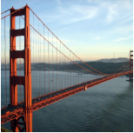
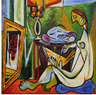
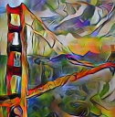
Goal
Content
Style
Resultant image

Slide 5
Methodology
The paper proposes to use feature transforms: whitening and coloring to directly match content feature statistics to those of a style image.
The feature transforms are coupled with a pre-trained general encoder-decoder network, so that the transfer is done via feed-forward operations.
Thus they do style transfer via an image reconstruction process coupled with feature transformations as above.
The reconstruction part is responsible for inverting features back to the RGB space and the feature transformation matches the statistics of a content image to a style image.

Slide 6
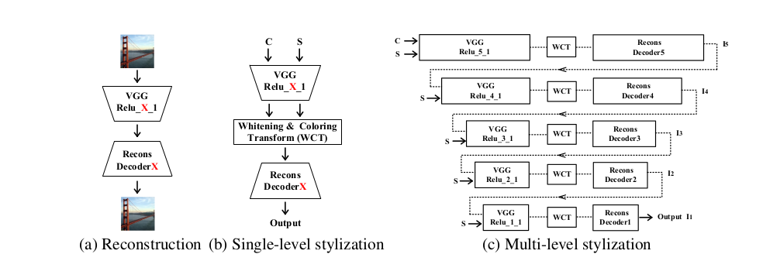
Pipeline

Slide 7
Pipeline (contd.)
Pre-train five decoder networks Decoder (X=1,2,...,5) through image reconstruction to invert different levels of VGG features.
With both VGG and Decoder X fixed, and given the content image C and style image S, perform the style transfer through whitening and coloring transforms.
Extend single-level to multi-level stylization in order to match the statistics of the style at all levels.
The result obtained by matching higher level statistics of the style is treated as the new content to continue to match lower-level information of the style.

Slide 8

Reconstruction Decoder
VGG-19 used as an encoder.
Decoder network is trained for inverting VGG features to the original image.
Designed as being symmetrical to VGG-19 network (up to Relu_X_1 layer), with the nearest neighbor upsampling layer used for enlarging feature maps.
Pixel reconstruction loss and feature loss are employed for reconstructing an input image.

Slide 9
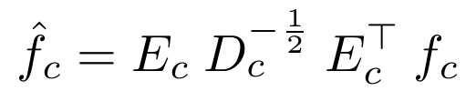
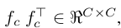

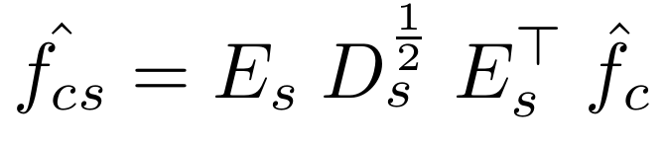
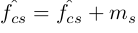
Feature Transforms
Extract vectorized VGG features maps f_{c} and f_{s} from content image and style image respectively.
Then we apply Whitening and coloring transforms as follows:
Whitening Transform
Where D_{c} is the diagonal matrix with the eigenvalues of the covariance matrix
and E_{c} is the corresponding orthogonal matrix of eigenvectors, satisfying
Coloring Transform
Where D_{s} and E_{s} are calculated in same manner as above.

Slide 10
Work done till now….
Single Level Stylisation
Modules coded:
Dataloader
Reconstruction Decoder
WCT transforms

Slide 11
Method of Experimentation
Tried single level stylisation on various style and content images combinations.
Kept style constant and varied content image.
Kept content image constant and varied styles.

Slide 12
Results: Single level Style Transfer

Slide 13
Kept style constant and varied content image.
Experiment 1

Slide 14
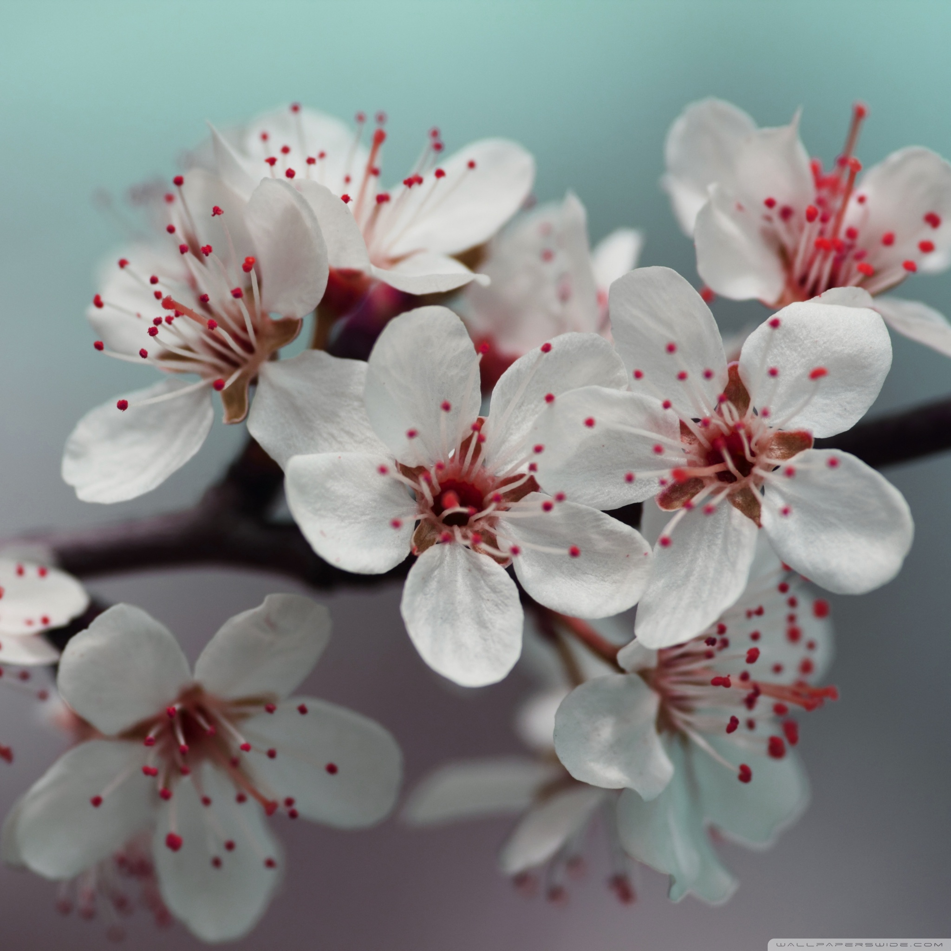

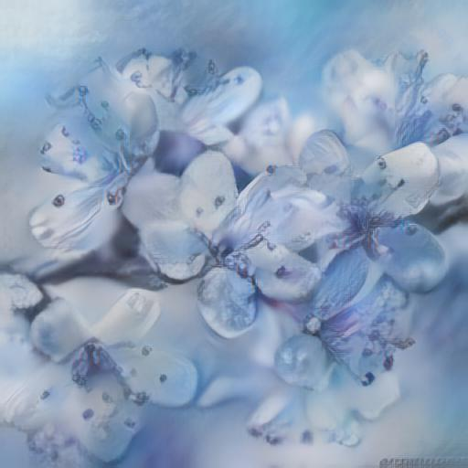
Content Image
Style
Transformed image

Slide 15
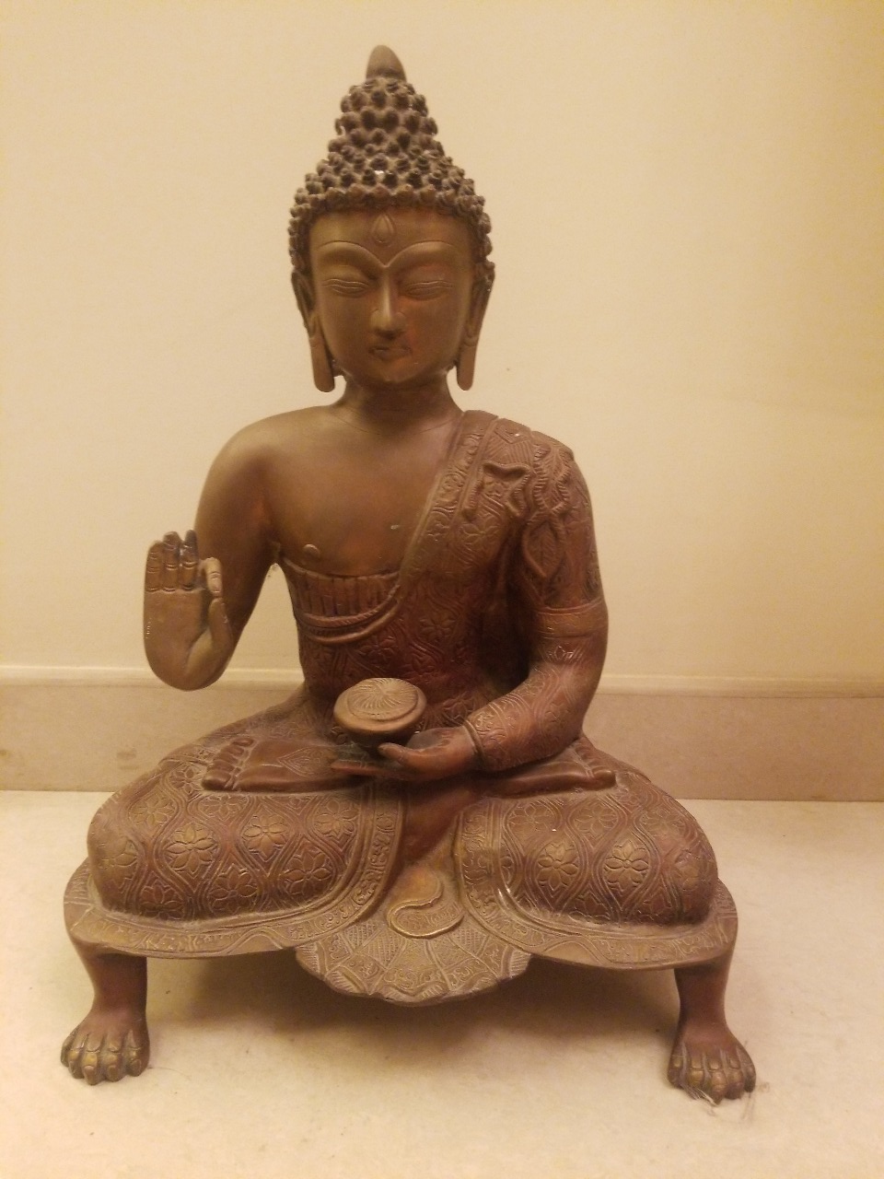
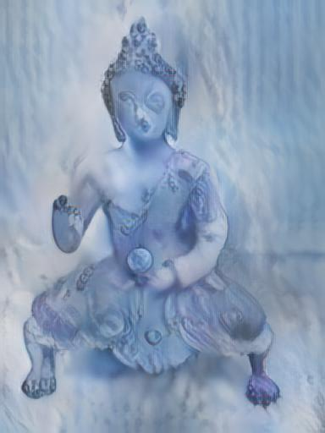
Content Image
Style
Transformed image

Slide 16
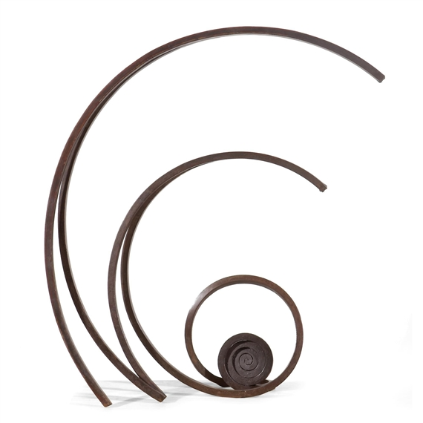
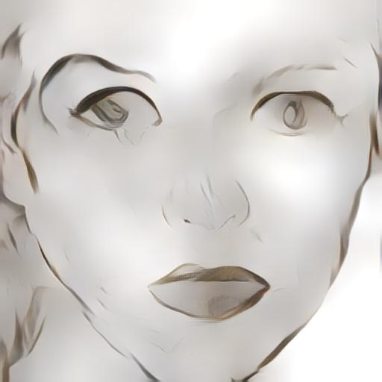
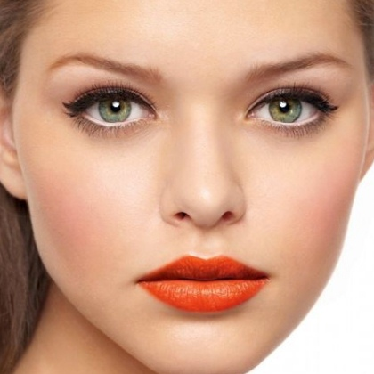
Content Image
Style
Transformed image

Slide 17

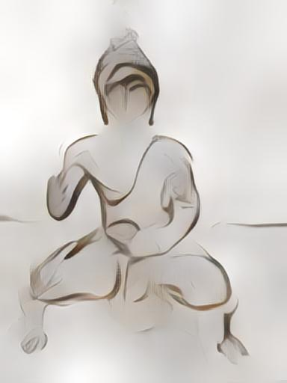
Content Image
Style
Transformed image

Slide 18
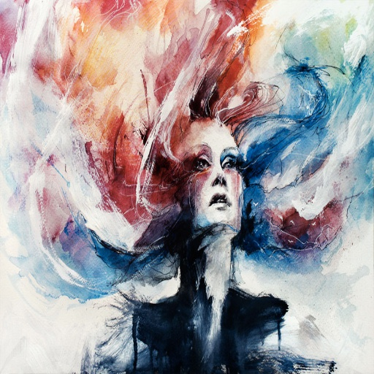
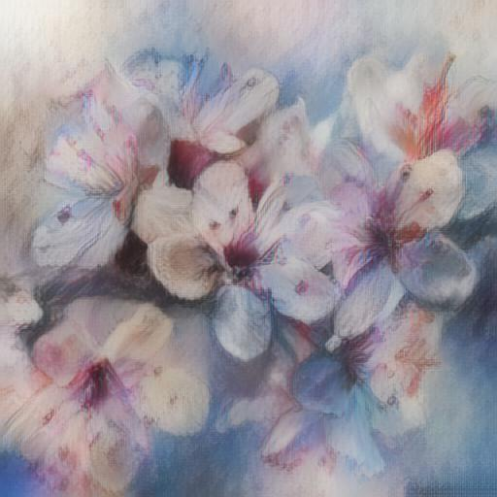
Content Image
Style
Transformed image

Slide 19
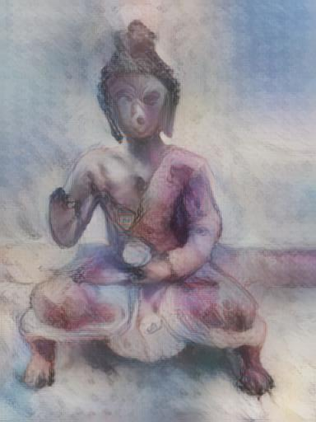
Content Image
Style
Transformed image

Slide 20
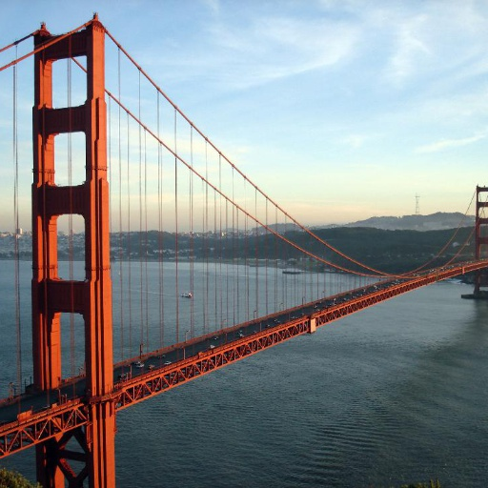
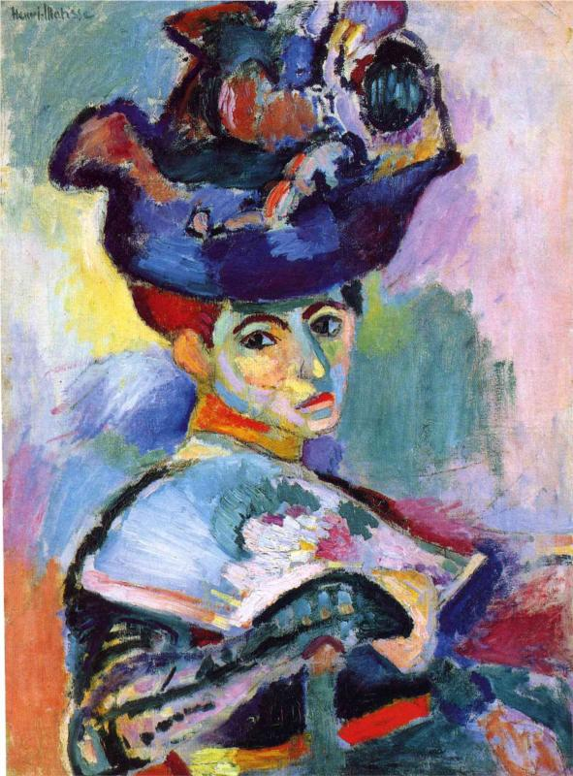
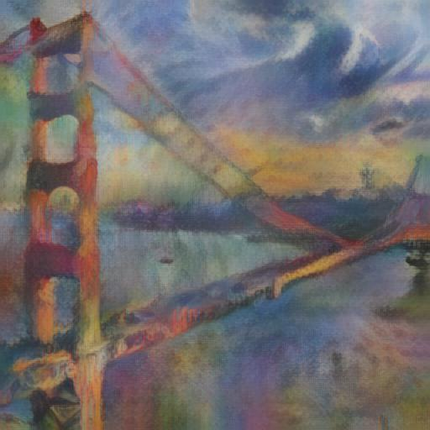
Content Image
Style
Transformed image

Slide 21
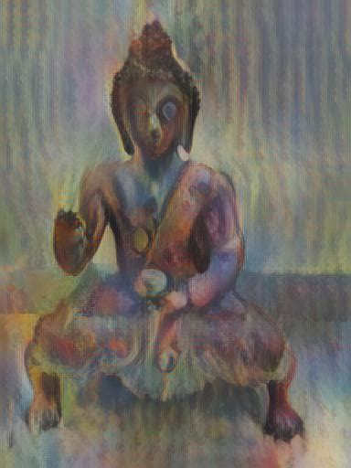
Content Image
Style
Transformed image

Slide 22
Kept content image constant and varied Style.
Experiment 2

Slide 23
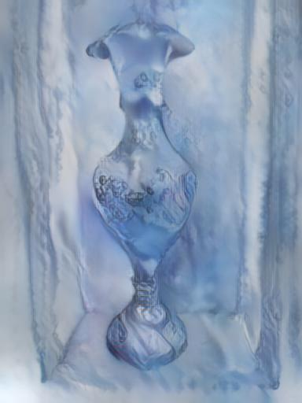
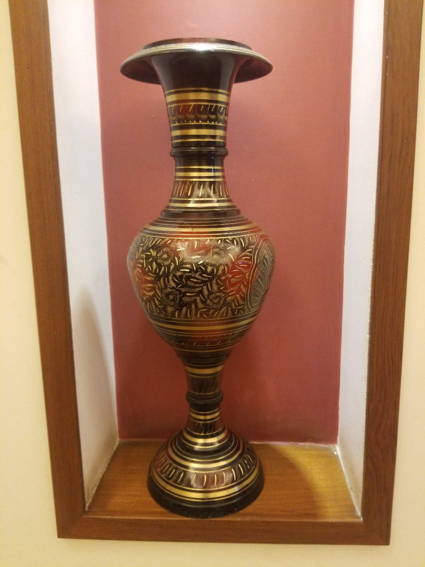
Content Image
Style
Transformed image

Slide 24
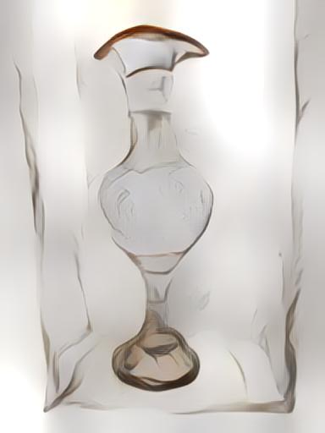
Content Image
Style
Transformed image

Slide 25
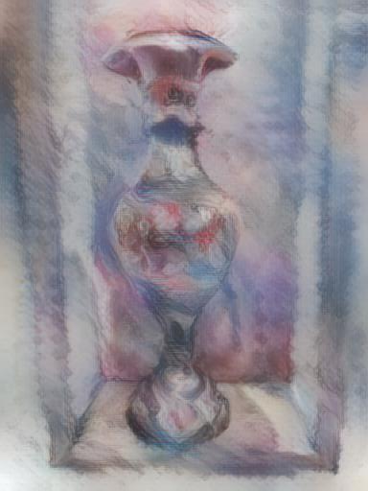
Content Image
Style
Transformed image

Slide 26
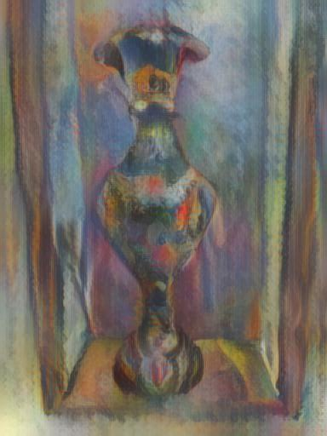
Content Image
Style
Transformed image

Slide 27
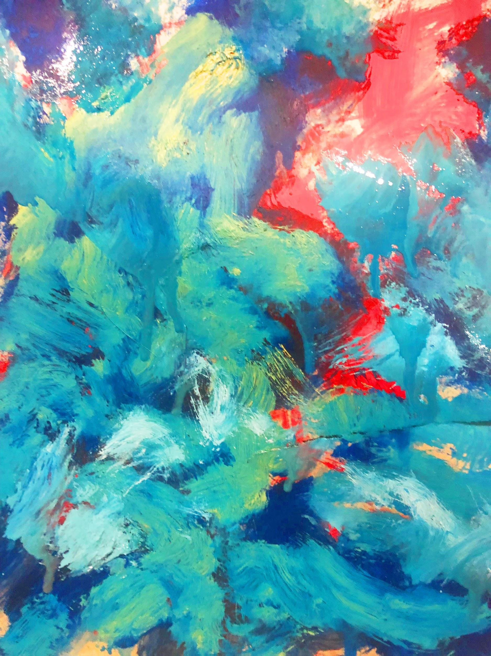
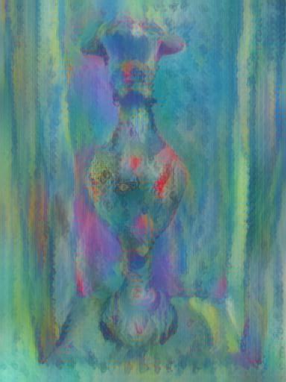
Content Image
Style
Transformed image

Slide 28
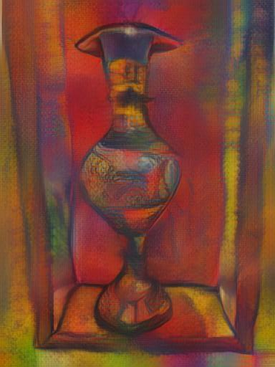
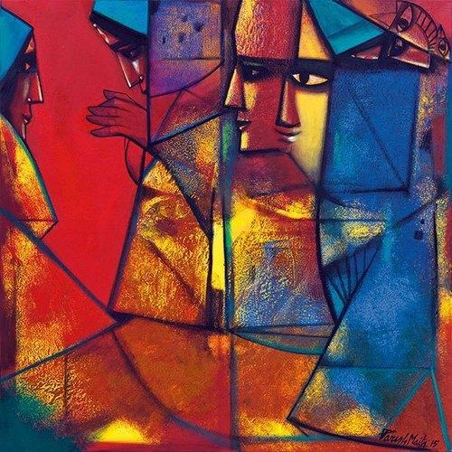
Content Image
Style
Transformed image

Slide 29
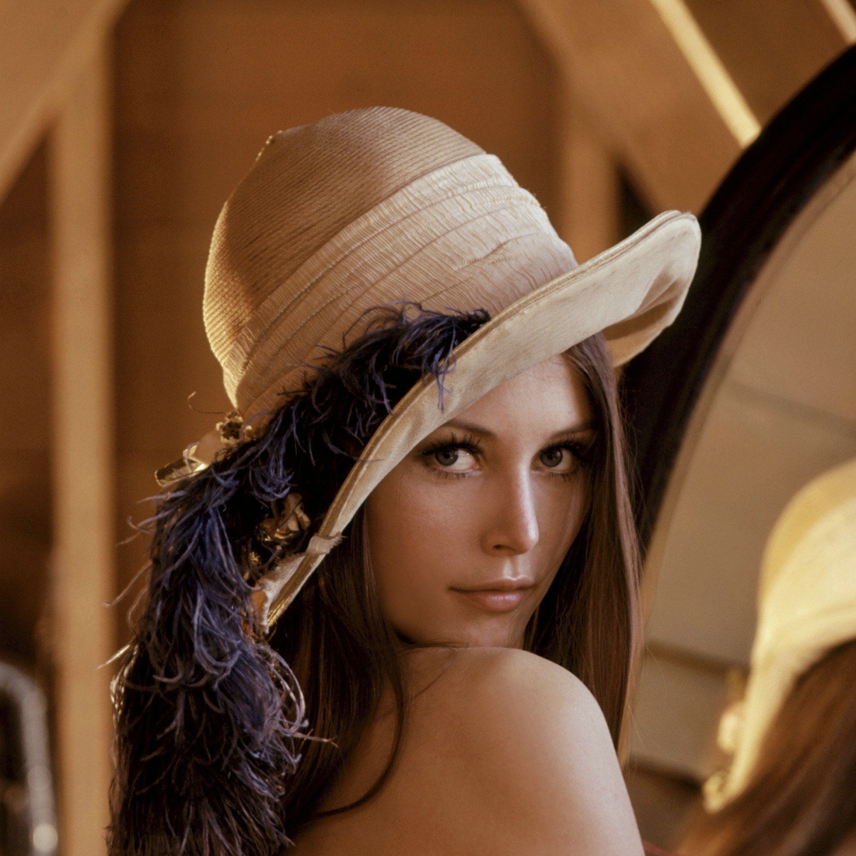
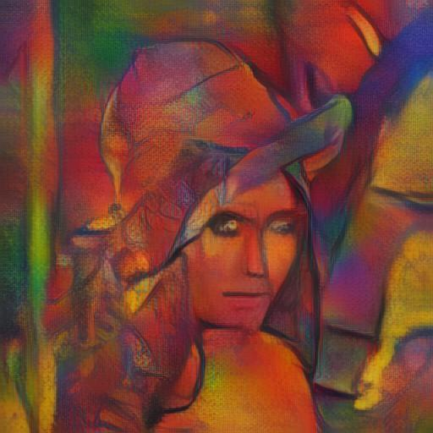
Content Image
Style
Transformed image

Slide 30
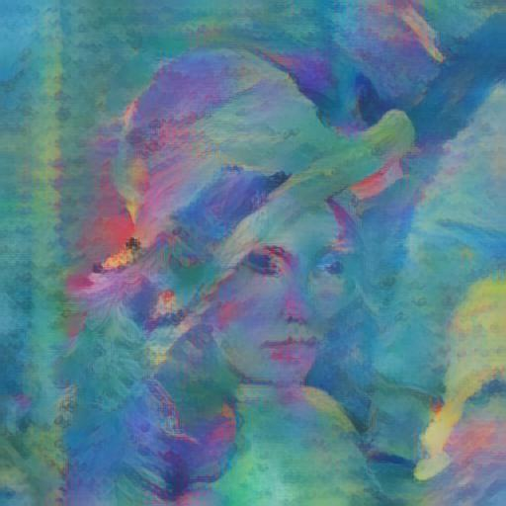
Content Image
Style
Transformed image

Slide 31
Next Steps
Multi-level coarse-to-fine stylization.
User Controls
User can control scale, weight and spatial features of style.
Scale can be controlled by varying size of input style image.
Weight is controlled by the style weight α in the feed-forward passes
Spatial control is provided via masks for specific regions and styles.

Slide 32
Frameworks and Libraries
Python (Pytorch)
OpenCV

Slide 33
Thank You!

